Slide 1

Case Study - Attrition

Slide 2
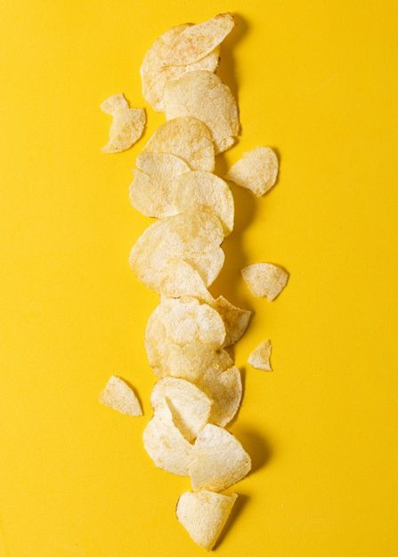
Dataset for attrition case study
ID
Age
DailyRate
DistanceFromHome
EmployeeCount
EmployeeNumber
EnvironmentSatisfaction
HourlyRate
JobInvolvement
JobLevel
JobSatisfaction
MonthlyIncome
MonthlyRate
NumCompaniesWorked
PercentSalaryHike
PerformanceRating
RelationshipSatisfaction
StandardHours
StockOptionLevel
TotalWorkingYears
TrainingTimesLastYear
WorkLifeBalance
YearsAtCompany
YearsInCurrentRole
YearsSinceLastPromotion
YearsWithCurrManager
OverTime
Over18
MaritalStatus
JobRole
Gender
EducationField
Education
Department
BusinessTravel
Attrition
Categorical variables - 10
Numerical variables - 26
Key stats
870 employees
Age range - 18 to 58 with average being 37 years
Attrition of Yes - 140 records, 16% of dataset
Majority of numerical variables’ values range from 0 to 4

Slide 3
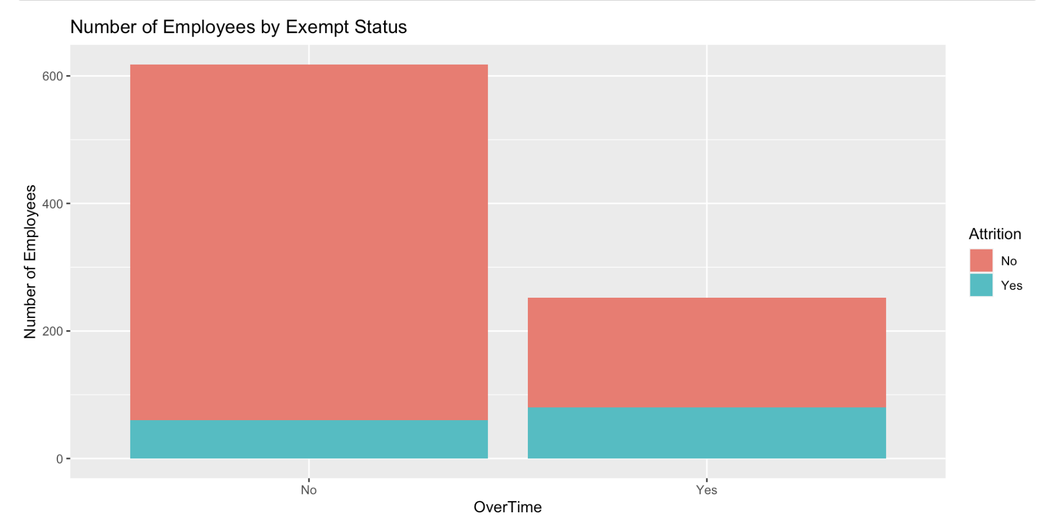
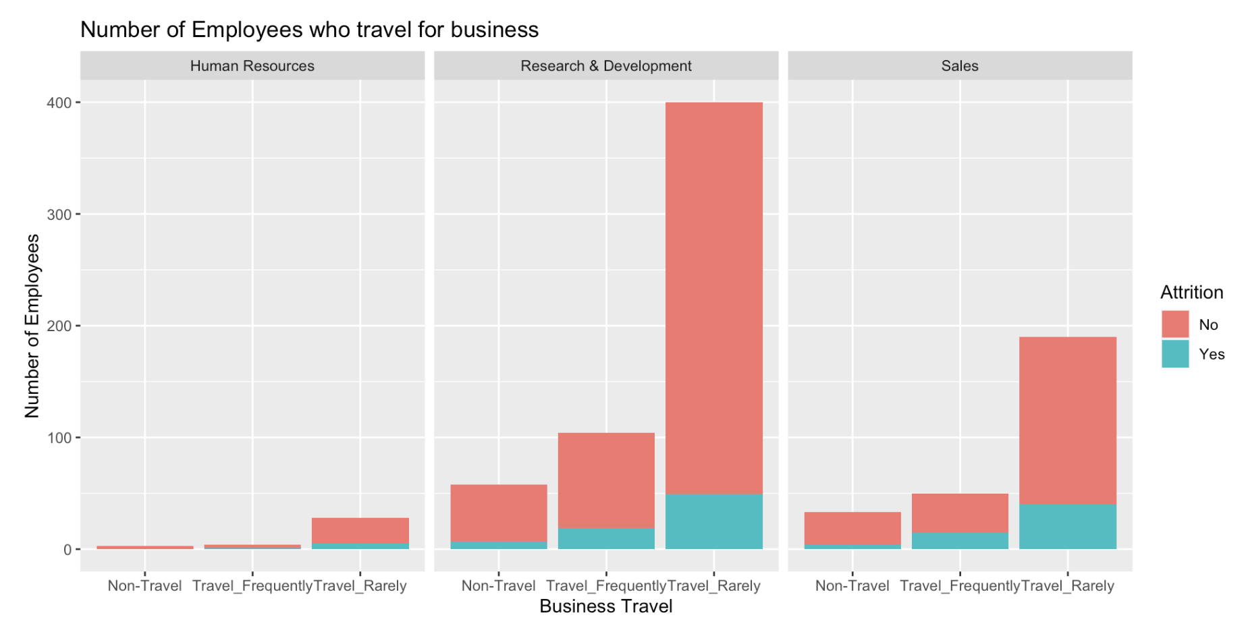
Exploring the Data

Slide 4

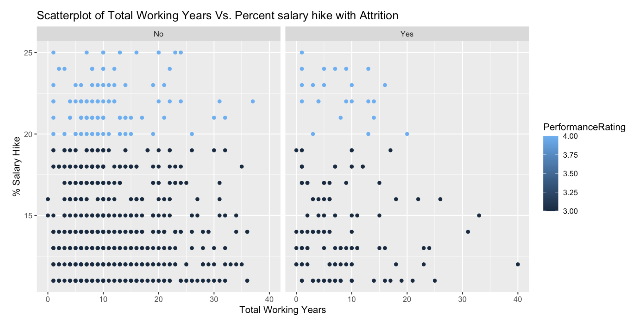
Exploring the Data

Slide 5
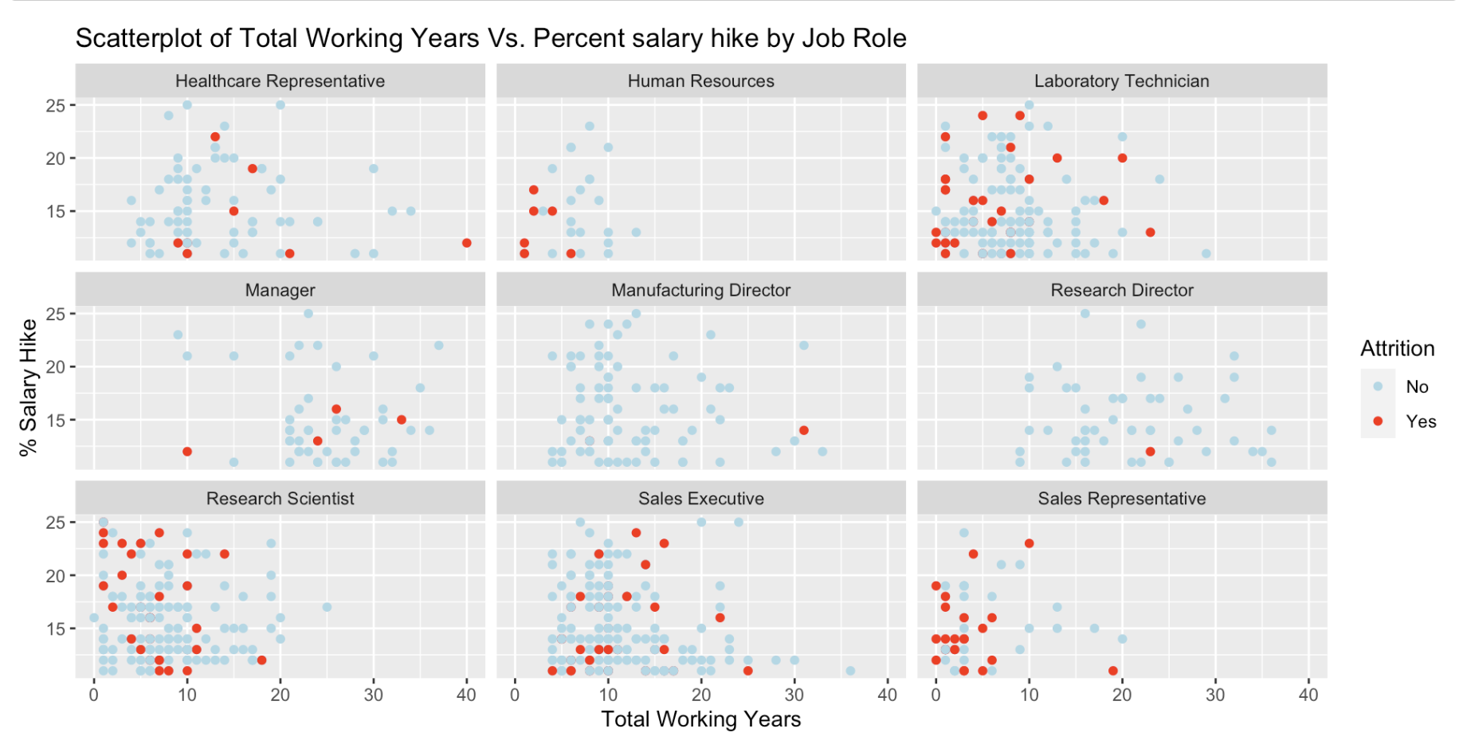
Exploring the Data

Slide 6
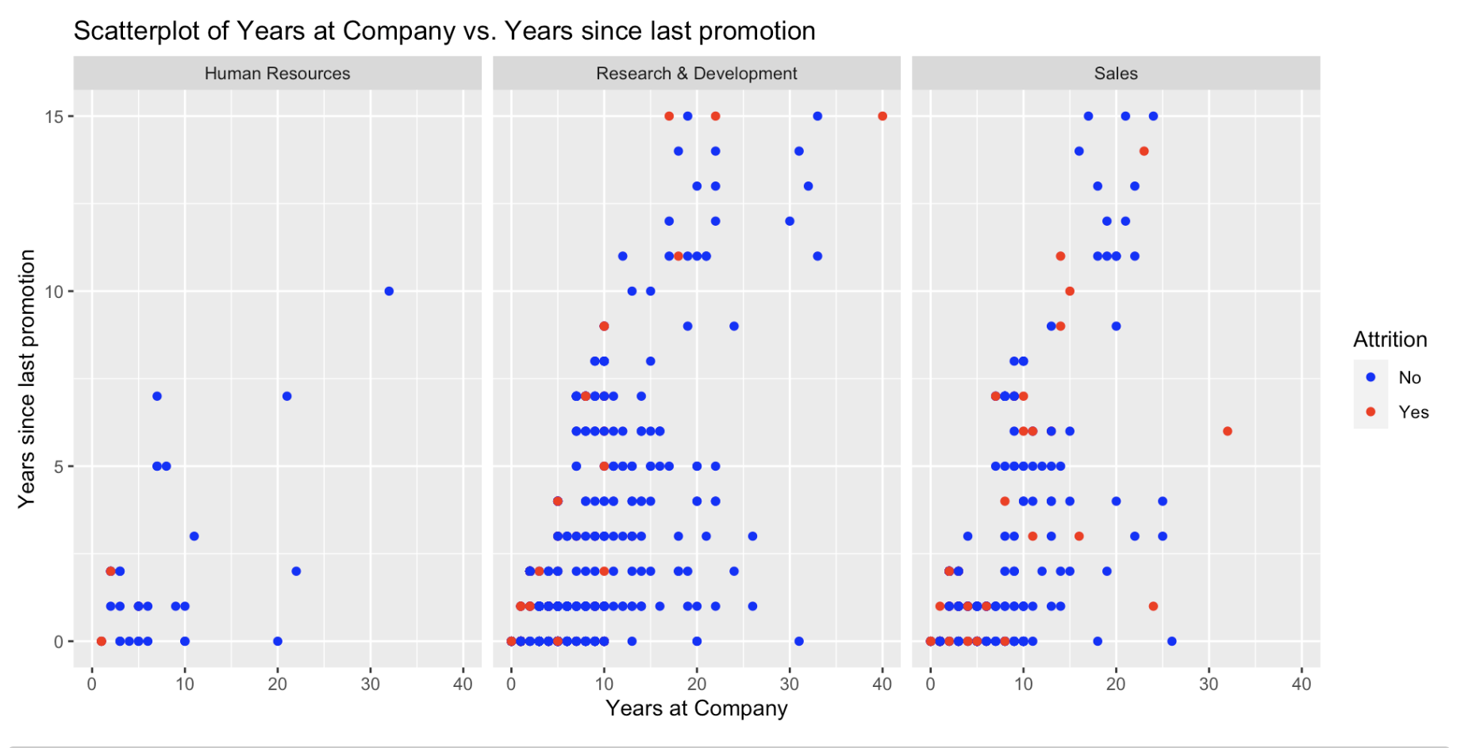
Exploring the Data

Slide 7

Performing t-tests
Test hypothesis sales roles are more likely to leave the company than other roles | Test hypothesis Research roles are more likely to leave the company than other roles | Test hypothesis HR roles are more likely to leave the company than other roles
p-value 0.002386 is less than the significance level of 0.05 | p-value 0.07258 is greater than the significance level of 0.05 | p-value 0.4498 is greater than the significance level of 0.05
Conclusion - there is a significant difference in attrition rates between the sales-related job roles group and the other job roles group. | Conclusion - no significant difference in attrition rates between the research tech -related job roles group and the other job roles group. | Conclusion - no significant difference in attrition rates between the HR job role group and the other job roles group.

Slide 8
Using knn to predict attrition
Trial & error to find the feature combination
Business travel
Distance from home
Number of companies worked
Overall satisfaction - Median of 3 measures
Job involvement,
Job satisfaction
Relationship satisfaction

Slide 9
Models - predict Attrition
knn Classifications | Attrition (N) (actual) | Attrition (Y) (actual)
Attrition (N) (Predicted) | 218 | 43
Attrition (Y) (Predicted) | 0 | 0
Specificity 0 for knn & 6.9% for naïve bayes
Unbalanced sample (16% yes for attrition) in dataset.
Try other sampling approaches to address imbalance
naïve bayes Classifications | Attrition (N) (actual) | Attrition (Y) (actual)
Attrition (N) (Predicted) | 218 | 40
Attrition (Y) (Predicted) | 0 | 3

Slide 10

knn models - predict attrition
knn models | Sampling approach | Precision | Sensitivity/ Recall | Macro F1
Under sampling | Y cases - 140 N cases - 140 sample from 730
Over sampling | N cases - 730 Y cases - resample from 140 to get to 730 records
91.2%
62.3%
55.3%
96.6%
67.8%
64.3%
Precision - proportion of true positives Of all the instances predicted as positive, how many are actually positive?
Sensitivity/ Recall - ability to correctly identify positive cases Of all the actual positives, how many were correctly tagged as positive?
F1 – Score - harmonic mean of precision and recall. Macro F1 - mean F1 of +ve & -ve class

Slide 11
Potential next steps
Deeper dive to identify top 3 drivers of Attrition from the list of 6.
Pick a pilot group each from job roles of Research Scientists & Sales Representatives to understand factors driving attrition.
6 features driving attrition
Business travel
Distance from home*
Number of companies worked
Overall satisfaction - Median of 3 measures
Job involvement*
Job satisfaction*
Relationship satisfaction*

Slide 12
Thank you!
Questions - mchandrashekaran@smu.edu

